Slide 1
Recording crustal tilt with the new NSWT in Lohja, Finland
Hannu Ruotsalainen
Finnish Geodetic Institute

Slide 2
Content
Some principles of interferometrical watertube tiltmeter
Construction and instrumentation of the new NSWT
First recordings
Crustal loading of Gulf of Finland

Slide 3
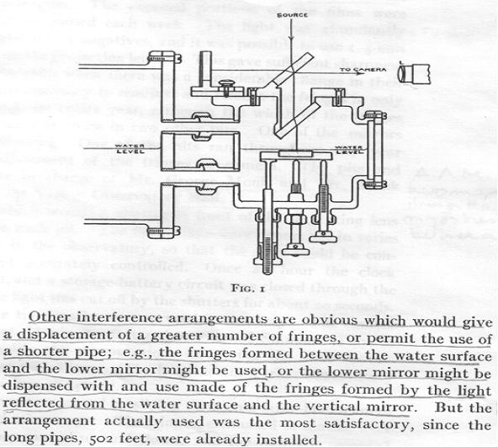
Michelson&Gale WT 1914-1919

Slide 4
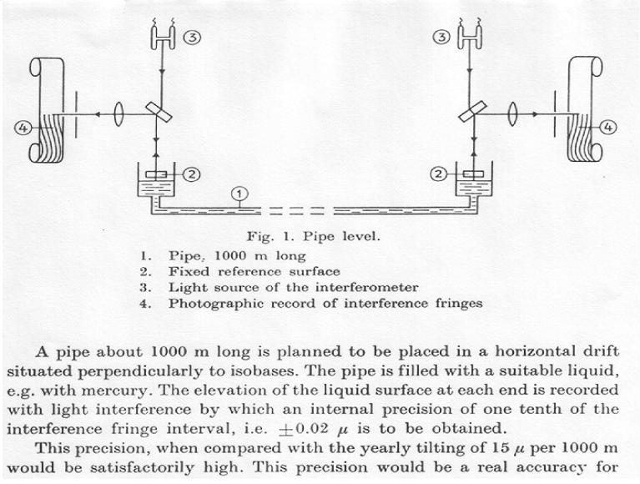
Kukkamäki 1 km landuplift tiltmeter plan in1965

Slide 5
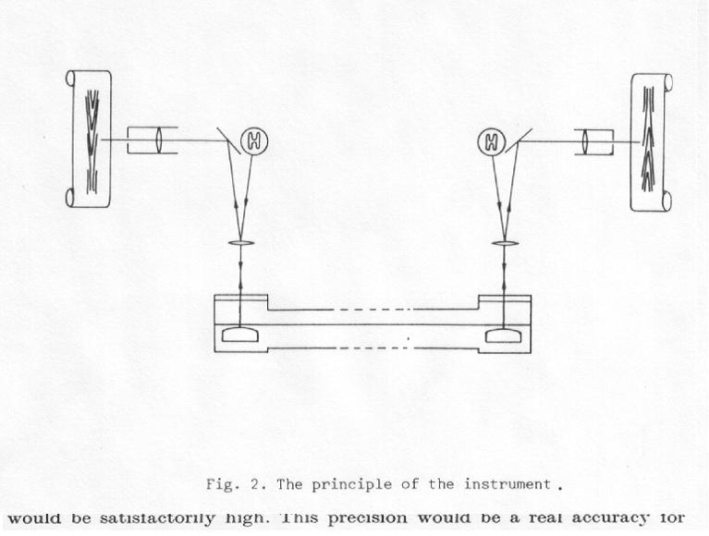
Kääriäinen NS & EW WT in Lohja 1977-1998

Slide 6
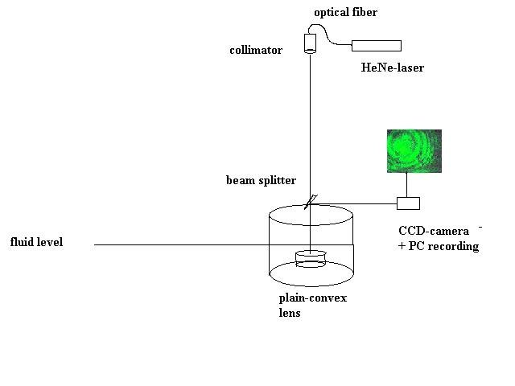
Ruotsalainen design

Slide 7
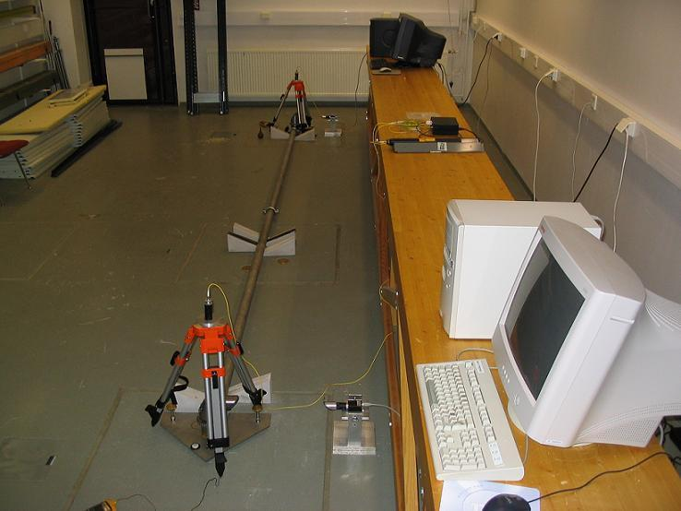
Prototype in FGI lab

Slide 8
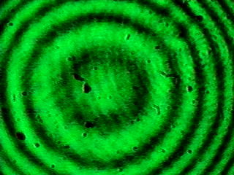
Fizeau level interferometer

Slide 9
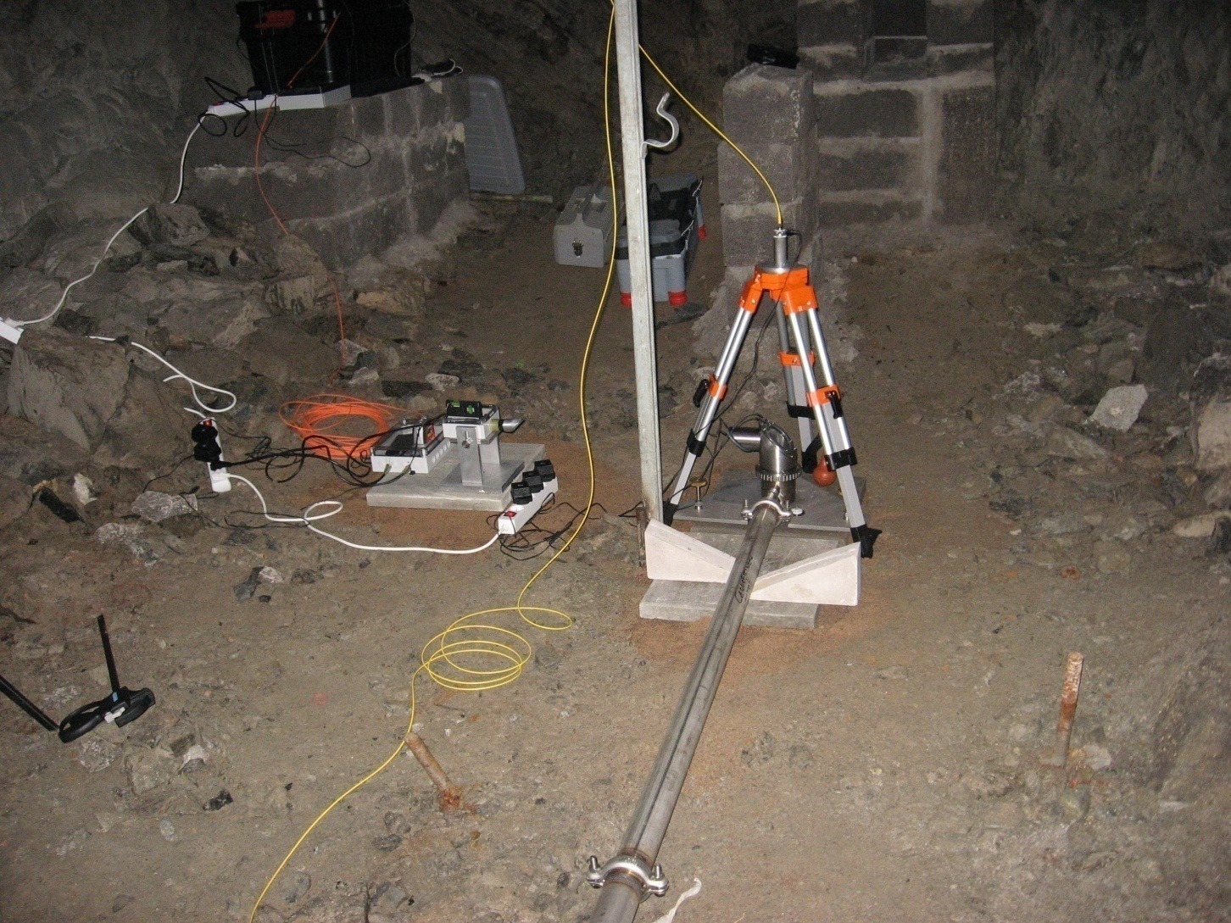
New 50.4 m long NSWT in Lohja mine

Slide 10
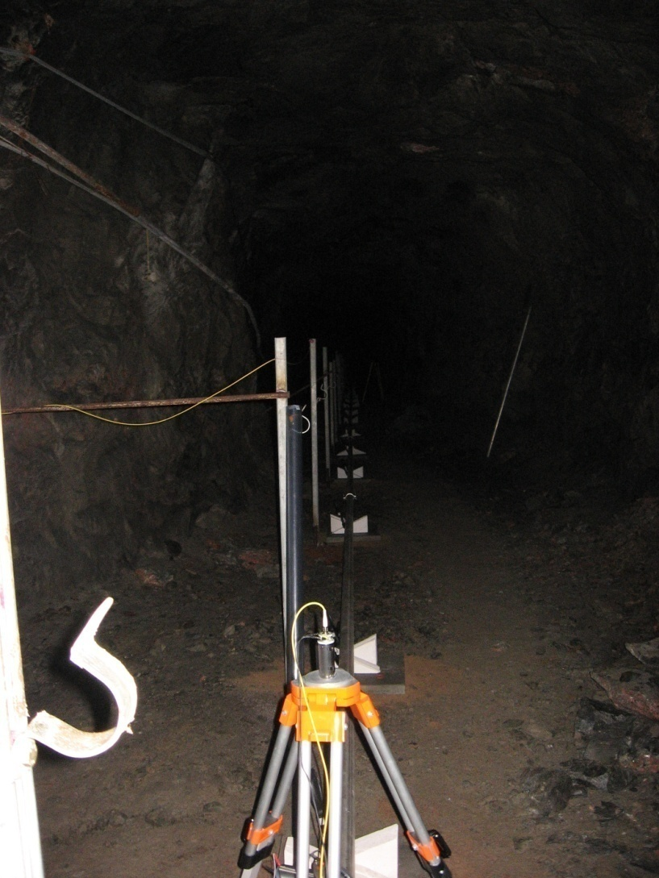
50.4 m long NSWT

Slide 11
Modernization during 2007-2008
Modular stainless steel tube & junctions laying on bedrock surface adjusted with concrete plates and triangle shape bricks to prepare stability
Possible leakages of 50.4 m tube line tested with high (~3 atm) air pressure
Pots plated inside with teflon to avoid fluid friction against pot walls
New 2 mW HeNe-lasers and collimators
Computer recording carried out from 200 & 250 meters away from interferometers by using fiberoptic links .

Slide 12
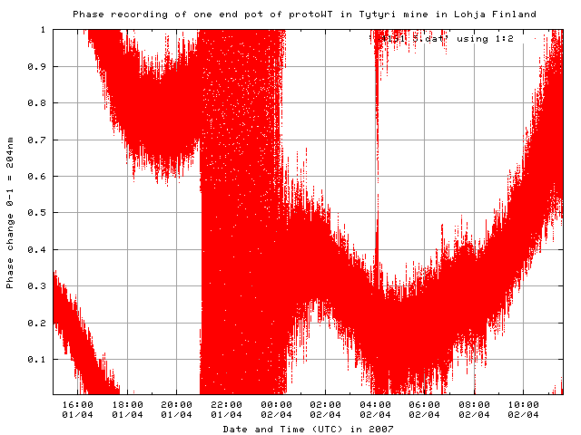
Earthquakes and seismics in phase recording

Slide 13
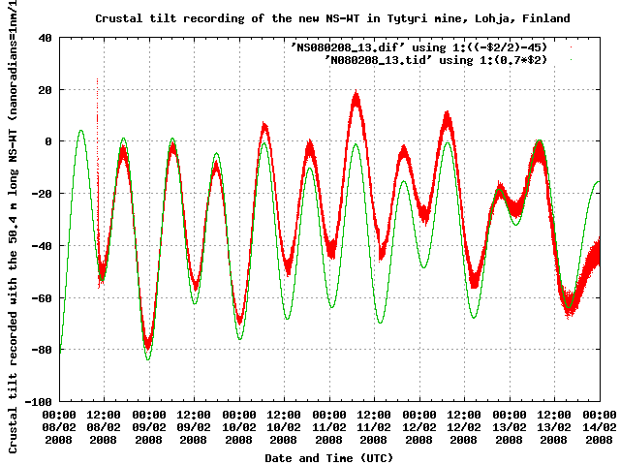
NSWT recording 2/2008

Slide 14
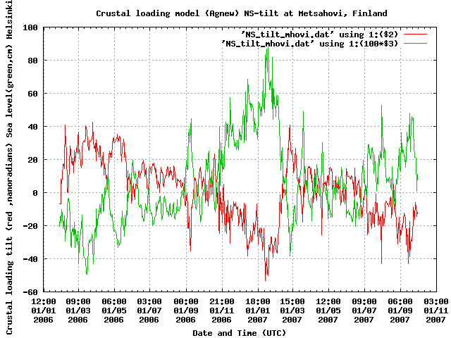
Loading of Gulf of Finland

Slide 15
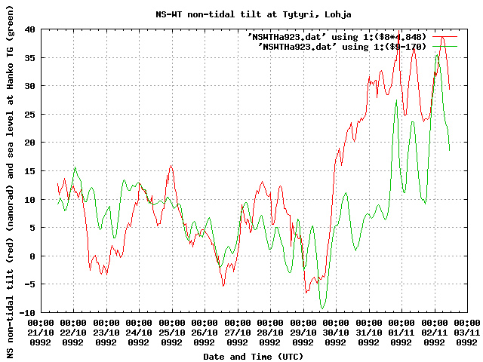
Residual of old NSWT and TG record of Hanko in 10/1992

Slide 16
Future
First tidal tilt analyse after 3 month of data
Comparison of non-tidal residual with Baltic Sea loading
Internet connection is planned to be built between Lohja and FGI to control recordings and download data and to use NTP timing of computers.

